Slide 1
Fivetran HVR Training
v1.0
Last updated: 06/05/24
Monitoring & Alerting

Slide 2
Monitoring & Alerting
Latency
Monitoring
Jobs View
Statistics
Topology View
Alerting
This module provides an overview of the monitoring options available in HVR, as well as discusses the configuration options for alerting.

Slide 3
Latency

Slide 4
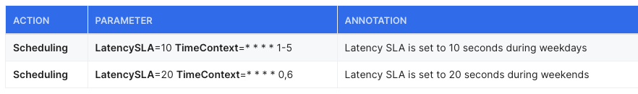







Latency
Latency represents the delay in replication
Capture latency is the delay in capturing the committed transactions from the source
Integrate latency is the delay end-to-end, from the source commit to the destination commit.
Latency is a job-wise value that is constantly increasing and only decreased at the end of successful cycles
Users can define Latency SLAs using a Scheduling action
The Latency SLA scope can be defined on a channel, location or location group and can have a Time Context to be active/valid at a defined time period

Slide 5
True or False? Users can configure different Latency SLAs for their capture and integrate jobs.
True. The scope Latency SLAs can be specific to locations.

Slide 6
Monitoring

Slide 7

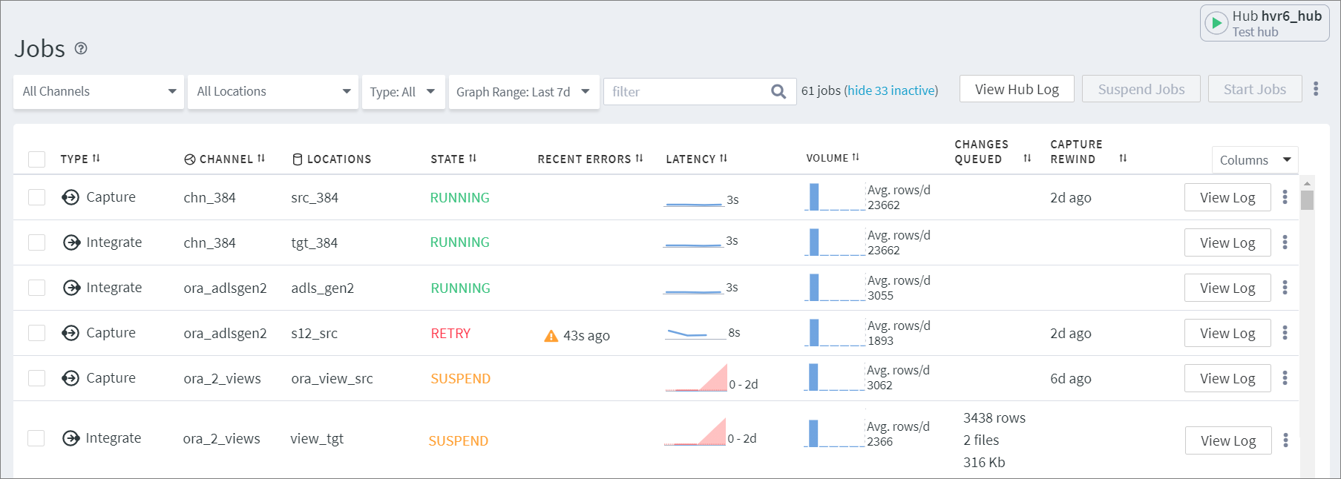

Monitoring
Real time monitoring is available on the graphical user interface, in the Jobs menu
Jobs View
Latency on the GUI is calculated from run-time transaction files stored in hvr_config
Users can be given read only access so they have access to the Jobs menu

Slide 8




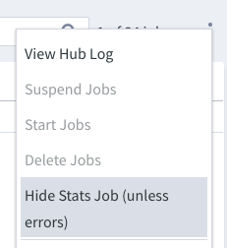
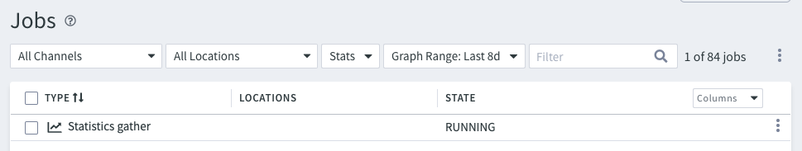
Monitoring
Stats Job
Responsible for gathering data displayed on the Statistics and Topology pages
Automatically created in a RUNNING state along with the repository tables
It gathers data from the log files, the router transactions files and the cap_state files
The Statistics gather job can be hidden while it is running with no errors

Slide 9


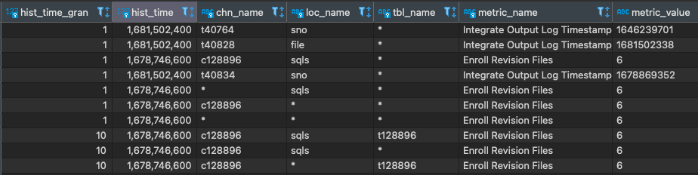
Stats Table
Automatically created in the hub repository databases. Populated with metrics gathered by the stats job.
Stats entry scopes are defined by channel, location or table name. Metrics are gathered with per-minute granularity and aggregated up to 10 minutes, 1 hour and 1 day
Can be stored in a secondary storage in CSV and can be replicated to a database target using the sample channel definition: hvr_stats_channel_example.json available in the HVR_HOME/examples/ hvr_stats directory

Slide 10
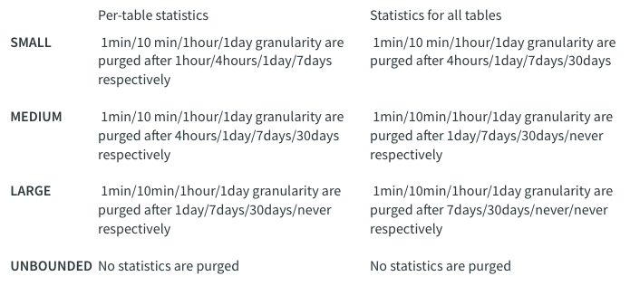

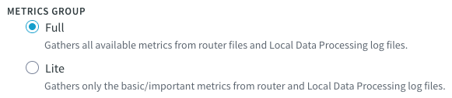
Statistics
Aggregation and Purging
Users can choose from 4 retention policies (default is MEDIUM)
Users can limit the gathered data to basic metrics

Slide 11
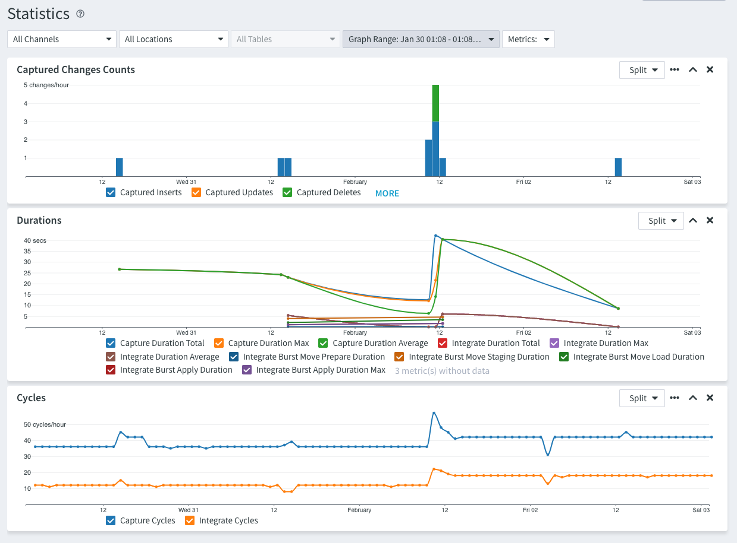
Monitoring
Statistics

Slide 12
Demo
How to use Statistics?

Slide 13
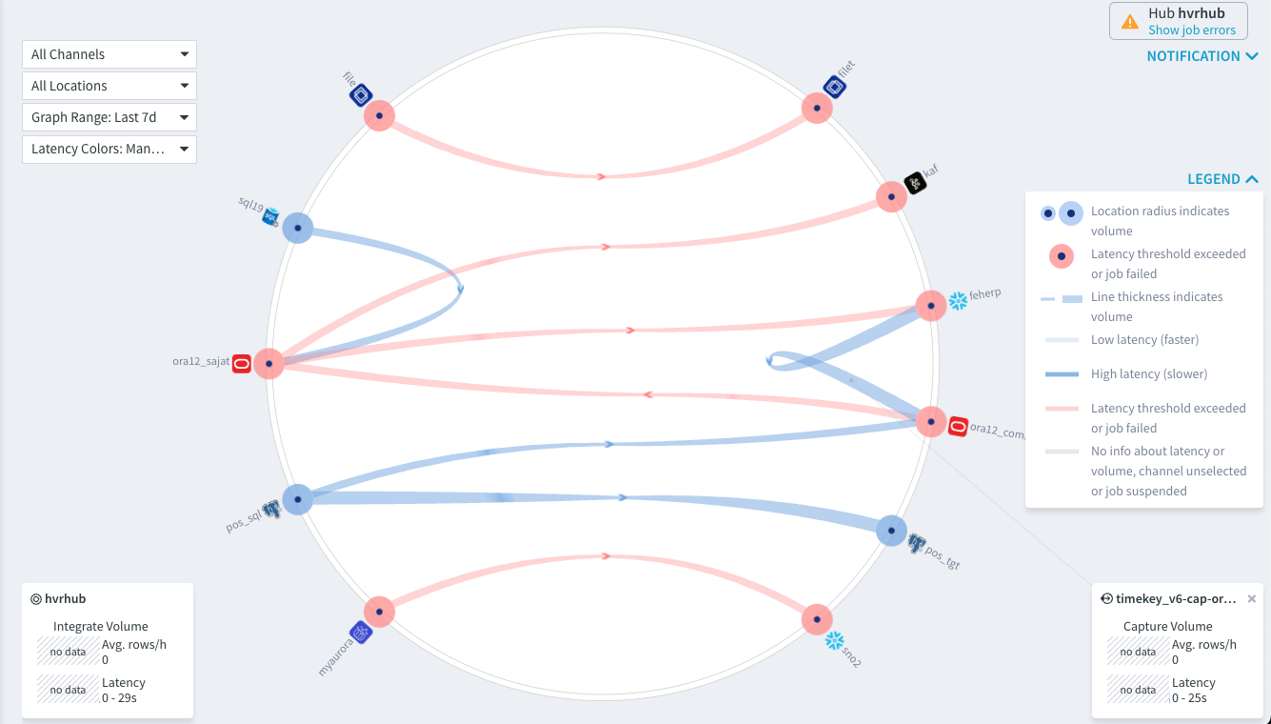
Monitoring
Topology View

Slide 14
Demo
How to use Topology?

Slide 15
True or False? Fivetran customers must use a separate tool for monitoring HVR.
False. Users can monitor replications in the Jobs, Statistics and Topology views on the GUI.

Slide 16
Alerting

Slide 17
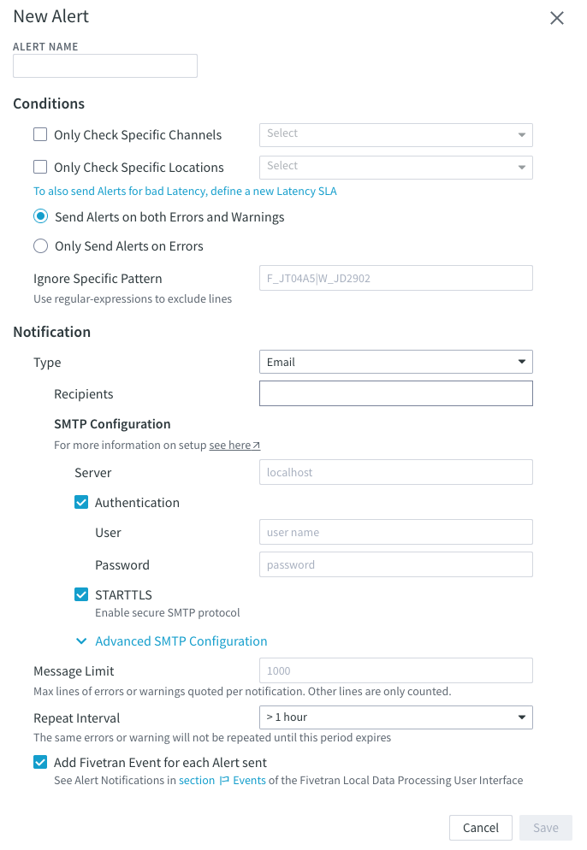
Alerting
Alerts are sent by a separate process called hvralertmanager
Hvralertmanager has to be scheduled outside of the product, directly in the OS
Hvralertmanager is responsible for all alerts across all (logical) hubs
Fivetran HVR scans the channel logs for warnings and errors
HVR can also detect Latency SLA violations
Notifications can be sent via email, Slack, SNS or SNMP
The alert manager logs are stored on the hub machine in HVR_CONFIG/logs/hvralertmanager.out

Slide 18
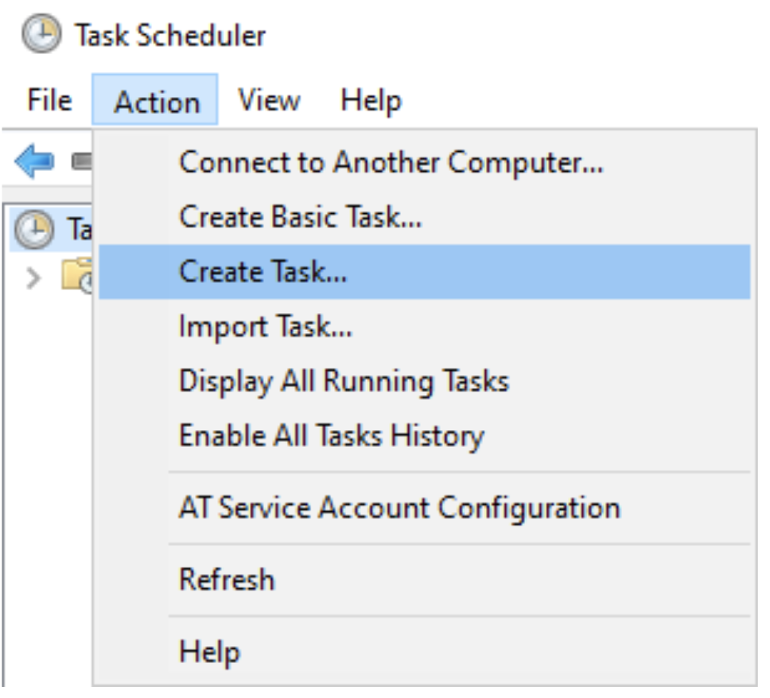
How to set up hvralertmanager
On Linux, run crontab -e and add the following entry: 0, 10, 20, 30, 40, 50 * * * * su hvr -c /home/hvr/hvr_home/bin/hvr -EHVR_HOME=/home/hvr/hvr_home -EHVR_CONFIG=/home/hvr/hvr_config hvralertmanager
On Windows, select Schedule Alert Manager in the installer or run the following command: C:\schtasks /create /sc /minute /mo 10 /tn HVR_Alert /tr C:\hvr\hvr_home\bin\hvralertmanager.exe
Alternatively, the task can be scheduled in the Task Scheduler. This can be accessed from Control Panel > Administrative Tools

Slide 19
True or False? Alerts for different channels are sent in separate notifications.
False.
All alerts are handled by the same hvralertmanager process and all errors are sent in a single notification.

Slide 20
Key Learnings
1
Dived into the meaning of latency.
Explored the different methods available to monitor HVR loads.
Learned how to interpret and leverage HVR Statistics.
Learned about the Topology view.
Learned how to set up alerts in HVR.
2
3
4
5

Slide 21
Q&A

